Slide 1
Development Economics
ECON 4915
Lecture 6
Andreas Kotsadam

Slide 2
Outline
Updated reading plan and some information.
Recap of empirical methods.
Possible exam question on insurance and recap from insurance lecture.
Natural resources.

Slide 3
Updated lecture plan etc.
Notes from lecture 5 and seminar presentations are on the web.
New lecture plan:
Lecture 8: Development and inequality GRY
Ray Ch 7; Galor
Lecture 9: Political and cultural change
Beaman et al.; Jensen and Oster

Slide 4
Recap of empirical methods.
4
Randomization requires minimal assumptions.
Non-experimental methods require assumptions that must be carefully assessed.
These assumptions cannot be proven so they must be very well argued.
Notes:
4

Slide 5
Some important concepts.
5
Identification strategy
Reduced form
Counterfactual
Internal and external validity
Notes:
5

Slide 6
Typical exam question
4a) Describe ways in which insurance can affect permanent income (same as “How may risk lead to poverty traps and what is the role of insurance?)” (3 points).

Slide 7
Typical exam question
4b) If we have data on individuals in a village and we observe that the change in consumption perfectly follows the change in village income and is completely unrelated to changes in income at the household level. Is this evidence of perfect insurance? (3 points)

Slide 8
Natural resources
Overview (Frankel)
Institutions (Mehlum et al)

Slide 9
Frankel (2010)
Survey paper.
Considers the arguments for and against the curse and goes through six specific mechanisms.
Offers policy responses and an analysis of existing policies.

Slide 10
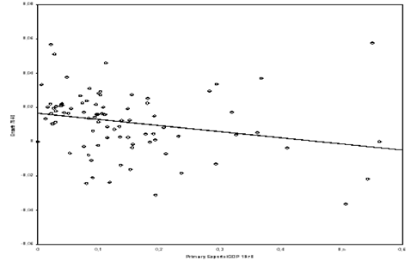
Exports of primary products and growth

Slide 11
Some econometric issues
Some studies find a negative, and some even a positive correlation.
Why?
    Control for different things.
    Different time periods, in particular in relation to discovery.
    Measurement issues:
      Endogeneity of exports.
      And also of natural endowments.

Slide 12
Six aspects of commodity wealth
Long-term price trends
Volatility
Crowding out of manufacturing
Civil war
Poor institutions
Dutch disease

Slide 13
Long-term price trends in commodity markets
Basically a “small open economy” argument.
But theoretically the trend can be upward or downward…
…and empirical evidence suggest that there is no long-term negative trend in world prices.

Slide 14
Volatility
Low demand and supply elasticities in the short run.
Why would volatility be harmful?
    Risk aversion.
    Difficult to plan and invest.

Slide 15
Crowding out of manufacturing
What happened to the comparative advantage hypothesis?
A counter argument is that industrial production entails more learning by doing than primary goods production.
Frankel is sceptical.
But see e.g. Ross (2008). ”Oil, Islam, and Women”.

Slide 16
Resources and (civil) war
High incentives to fight over control for the resources.
Many studies find a correlation between conflict and resources.
But not everyone agrees.

Slide 17
The effect of resources on institutions
Proposed mechanisms:
    Internal struggle for ownership.
    Inequality.
    Corruption.
But are natural resources really exogenous to institutions?

Slide 18
The Dutch disease
When upward swings in world prices cause:
    Real appreciation in the currency.
    Increased government spending.
    Increased relative price of nontraded goods.

Slide 19
Policy solutions
Reduce the impacts of volatility.
Spread risks.
Fiscal policy to make savings (as opposed to spending) procyclical.
Imposition of external checks and balances.

Slide 20
Mehlum, Moene, and Torvik 2006
The basic argument is that institutional differences determines whether natural resource abundance is a blessing or a curse.
“Imagine that a valuable natural resource is suddenly discovered both in Afghanistan and Switzerland. What would the economic consequences in each of the two countries be? Would the new wealth turn out to be a curse or a blessing?”

Slide 21
Three perspectives on the role of institutions in the link between growth and natural resources
Resources harm institutions, and therefore growth.
There is no link, resources are bad for growth via the Dutch disease.
Resources interact with institutions.

Slide 22
Theory
Two types of institutions:
    Grabber friendly: Rent-seeking and production are substitutes.
    Producer friendly: Rent-seeking and production are complements.
Rent-seeking: attempts to obtain economic rents by manipulating environment in which economic activities occur, rather than by creating new wealth.

Slide 23
Assumptions behind the model
Producers and rent-grabbers stem from the same limited pool of entrepreneurs;
The entrepreneurs allocate themselves between production and grabbing until the return in both alternatives are equal;
Grabbers fight for natural resource rents and feed on the producers, implying that the return to grabbers depends negatively on their number;
In production there are joint economies implying that the return to producers depends positively on their number.

Slide 24
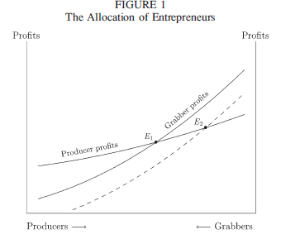

Slide 25
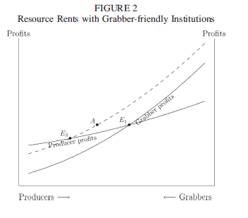

Slide 26
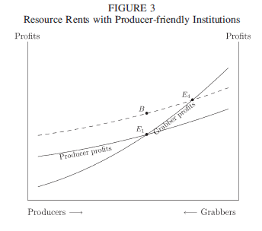

Slide 27
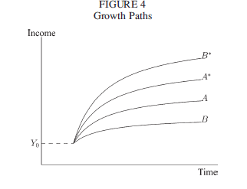

Slide 28

Findings
Their key empirical result is that the resource curse is weaker the higher the institutional quality:

